Slide 1
Intro to Neutral-atom Quantum Computing
MIT iQuHack
Pedro Lopes, PhD + Phillip Weinberg, PhD

Slide 2
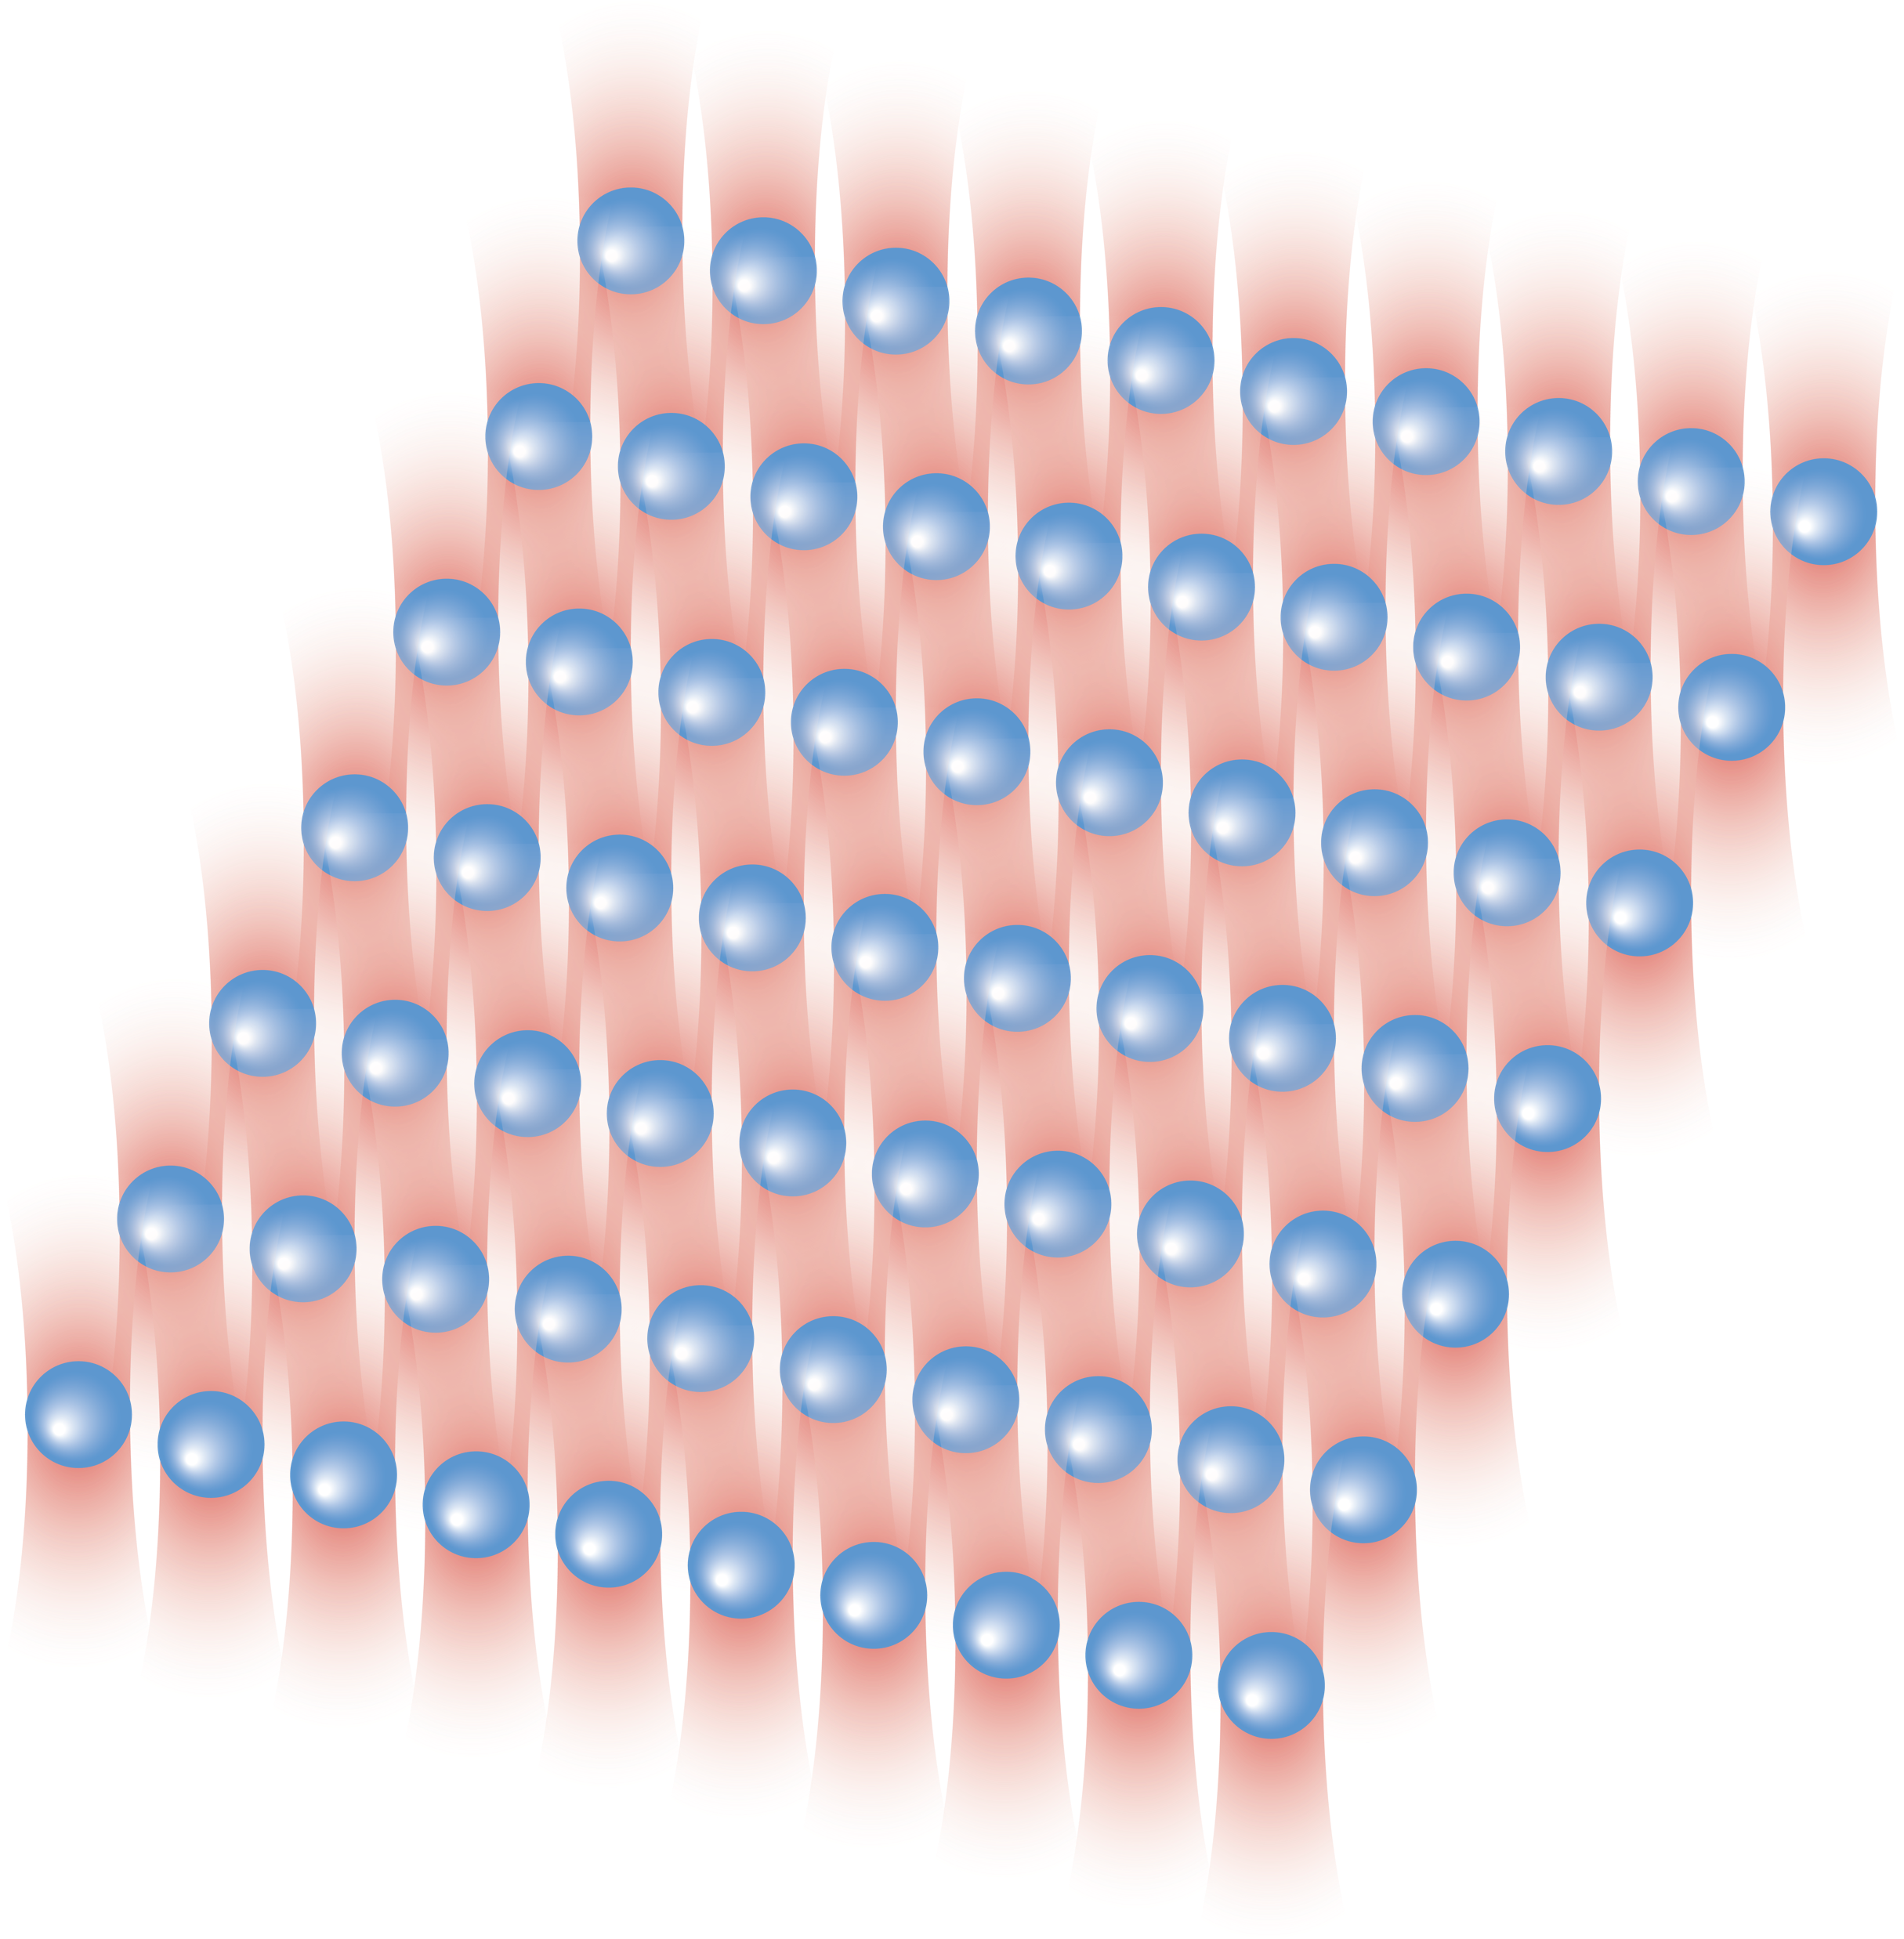
Why neutral-atom quantum processor
Densely packed qubits (atoms)
Efficient qubit control
Flexible problem encoding
The fastest path to quantum error cor
New ways to think quantum computing!

Slide 3

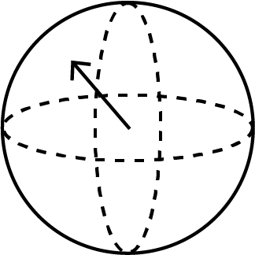

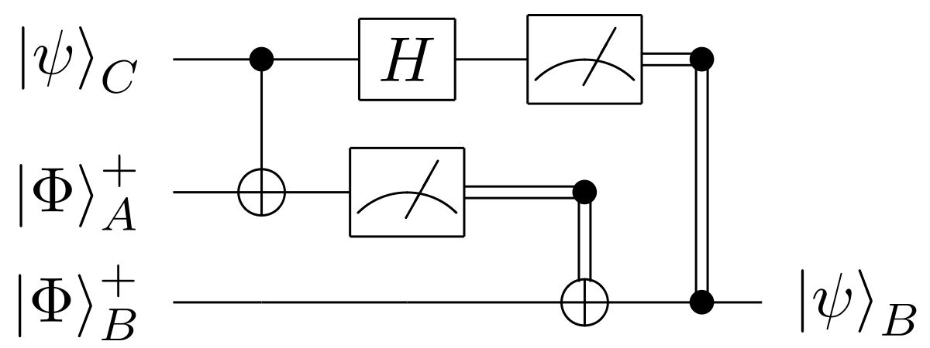
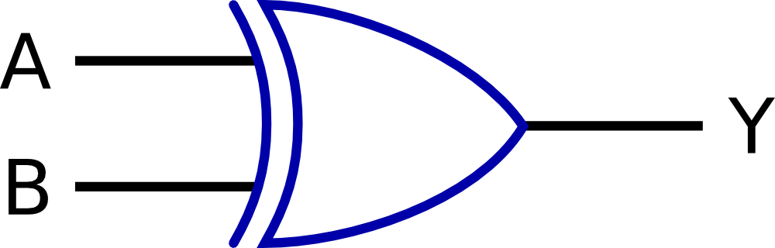

Quantum computing == new rules!
Classical
Quantum
Information input
bits
qubits
Information processing
Logic gates
Quantum gates
Results & output
Deterministic
Probabilistic & deterministic

Slide 4
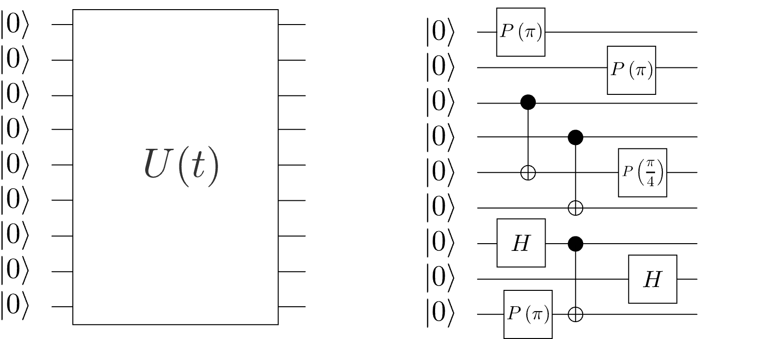


Paradigms of Q. Information processing
Analog operation
Digital operation
Designed for the early stage of maturity of the quantum computing resources of today…
Robustness to errors
Efficient control
Single-step large entanglement
Universal applicability
More on analog processors:
Nature volume 607, p. 667–676 (2022)

Slide 5
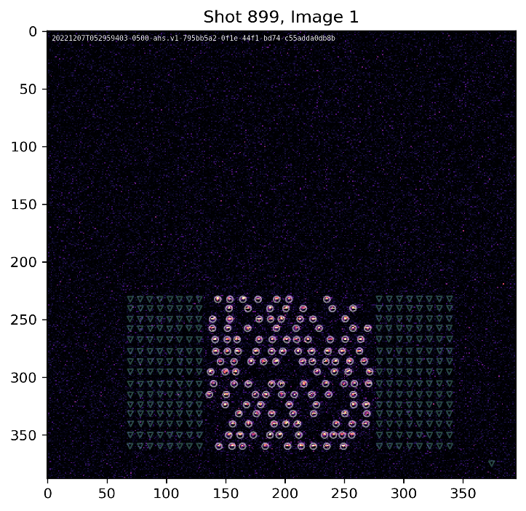
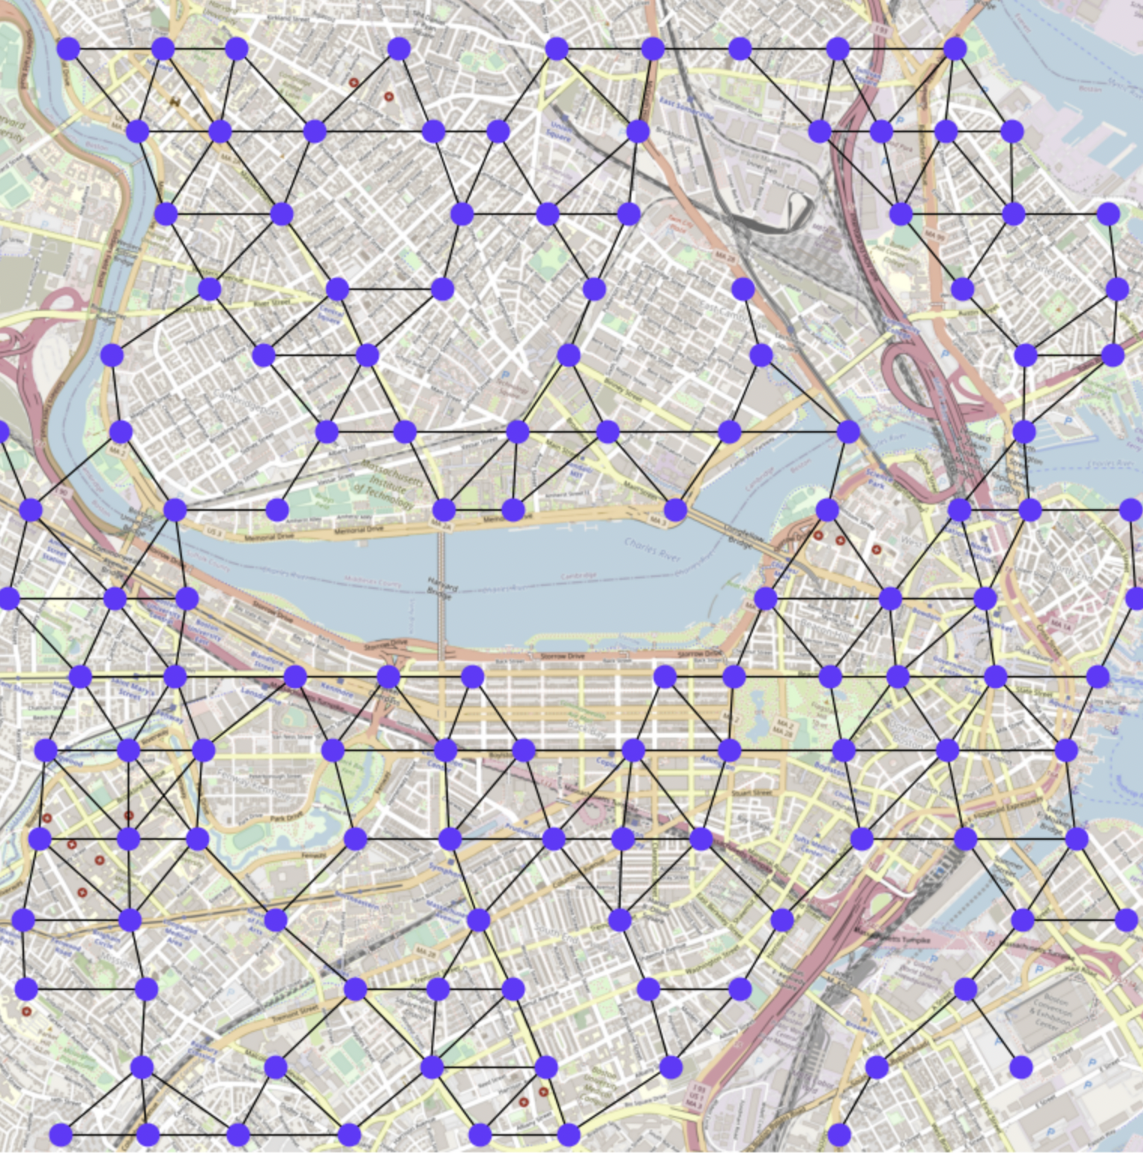
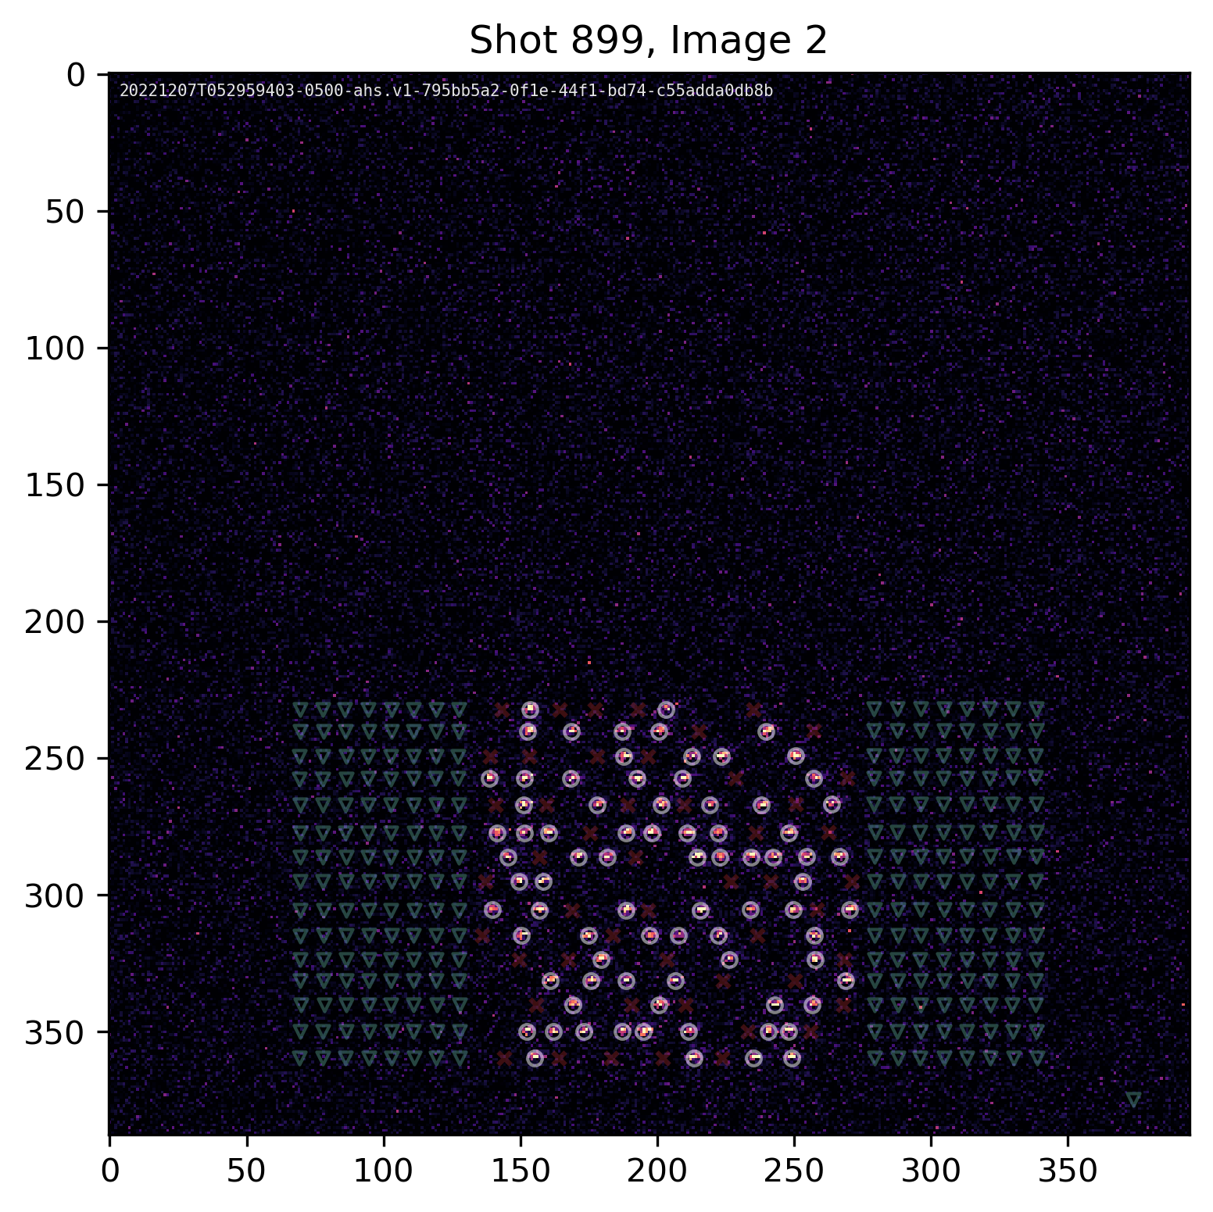
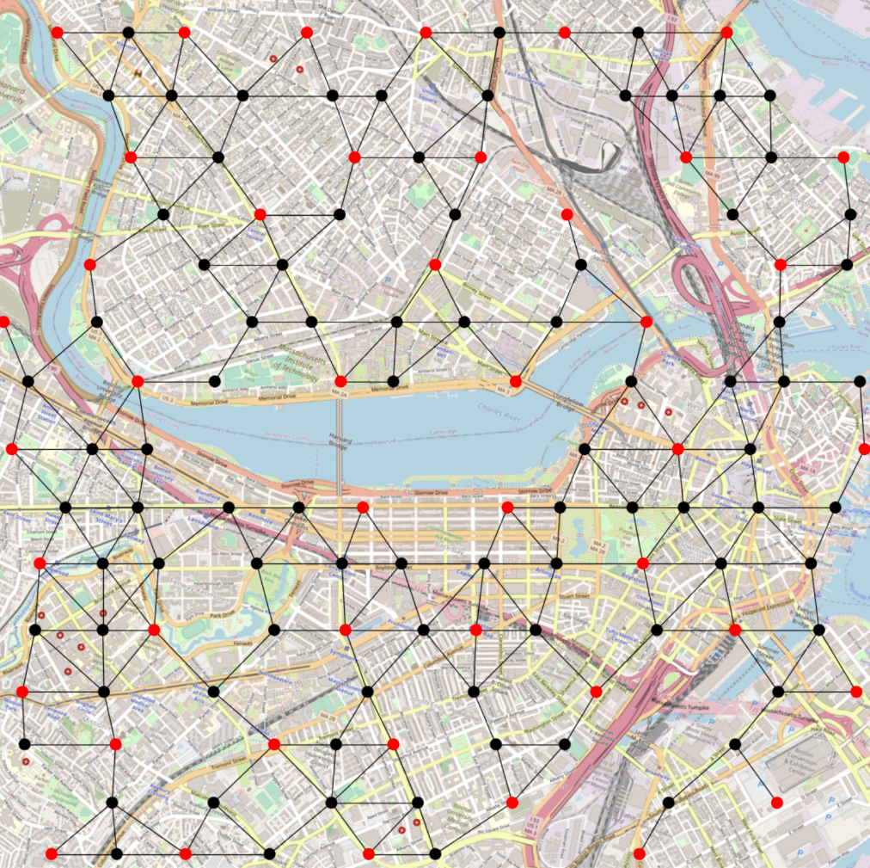
FPQA = Efficient Problem Encoding
Problem: choosing optimal locations in Boston
Possible locations as atom coordinates
Solution

Slide 6
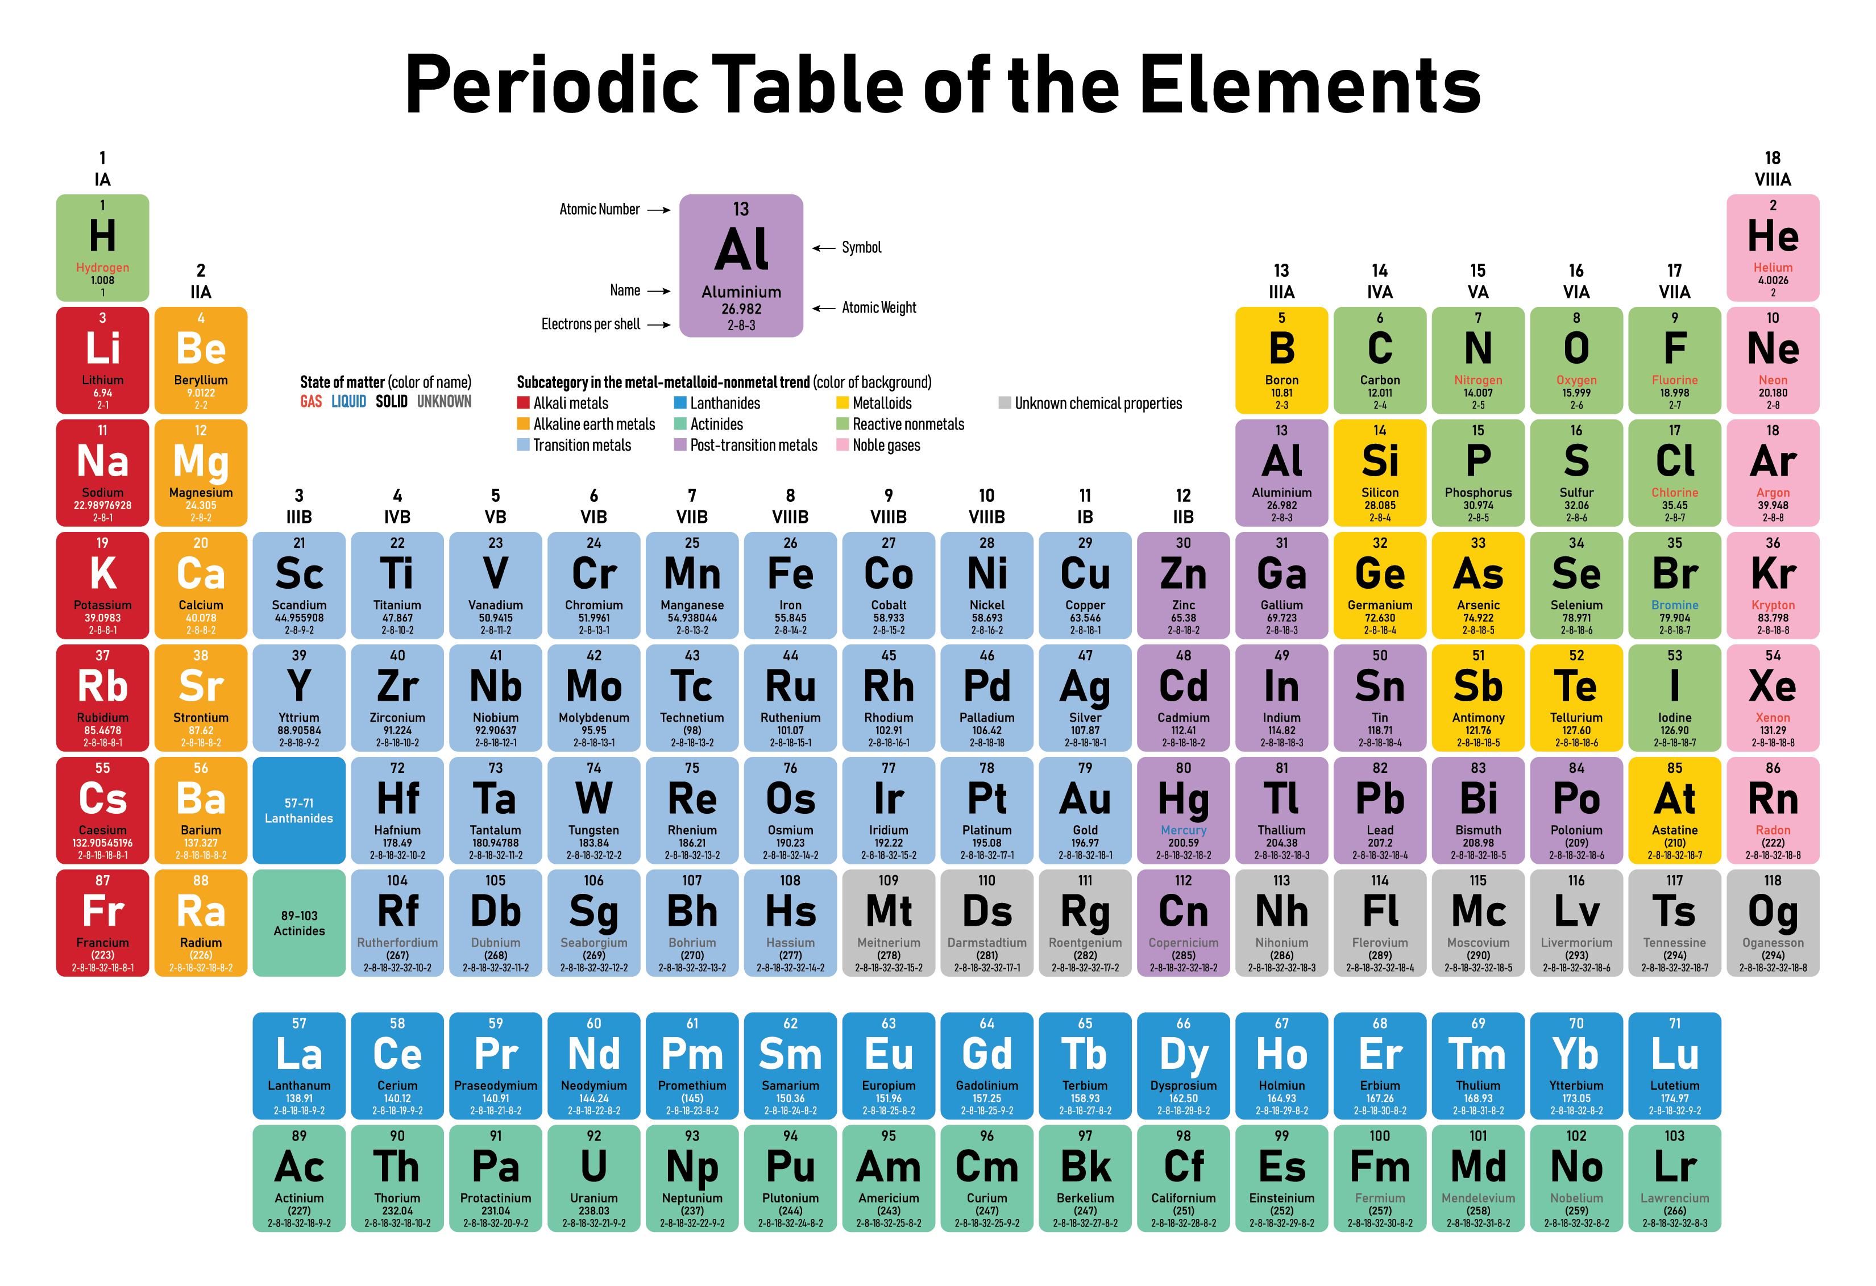
Architecture: qubits by puffing-up atoms

Slide 7
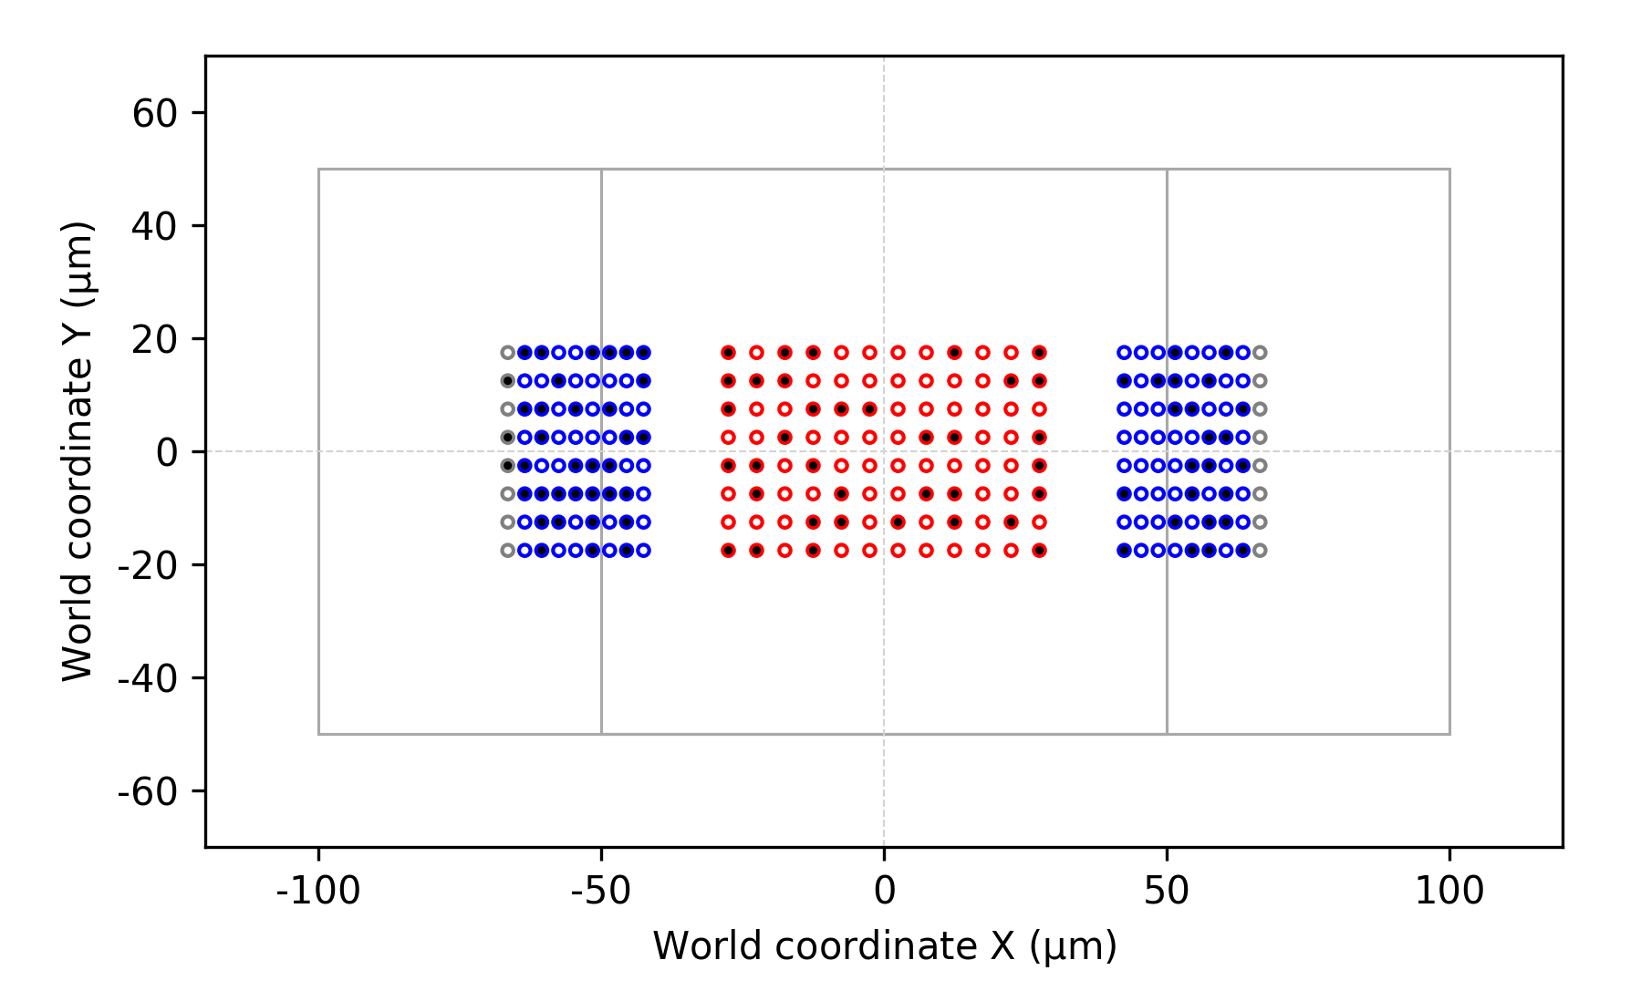
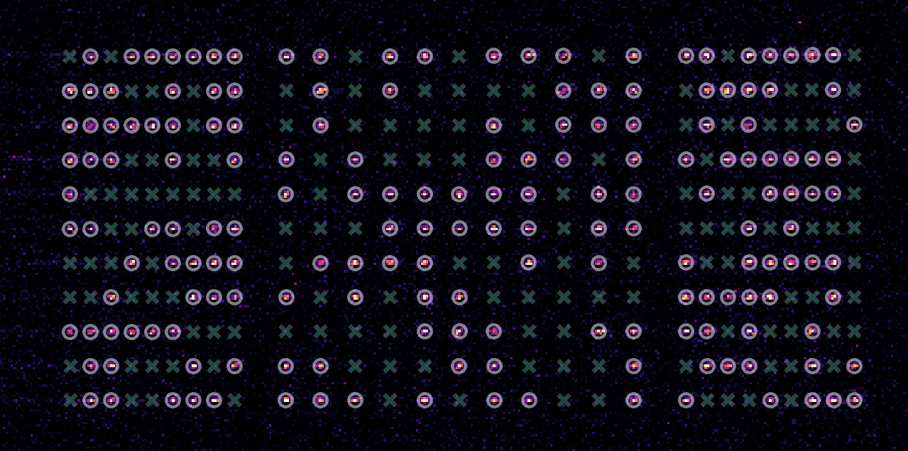
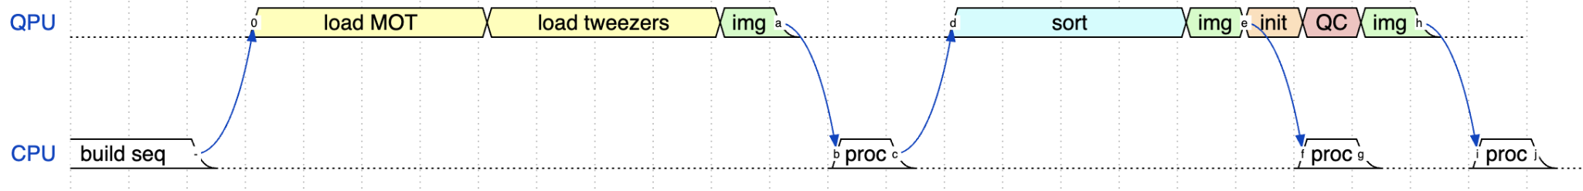
QPU cycle
15ms
20ms
5ms
15ms
40ms
5ms
20us
15ms
40ms
5ms
5ms
Notes:
We build the processor at each shot.
Large dynamic range of time: 100s of ms duration for QPU cycle and calibrations, to 10s of ms duration prep step, to 0.1-20us Hamiltonian control analog waveforms with 10ns timing precision.
Crossover from ms to ns.

Slide 8
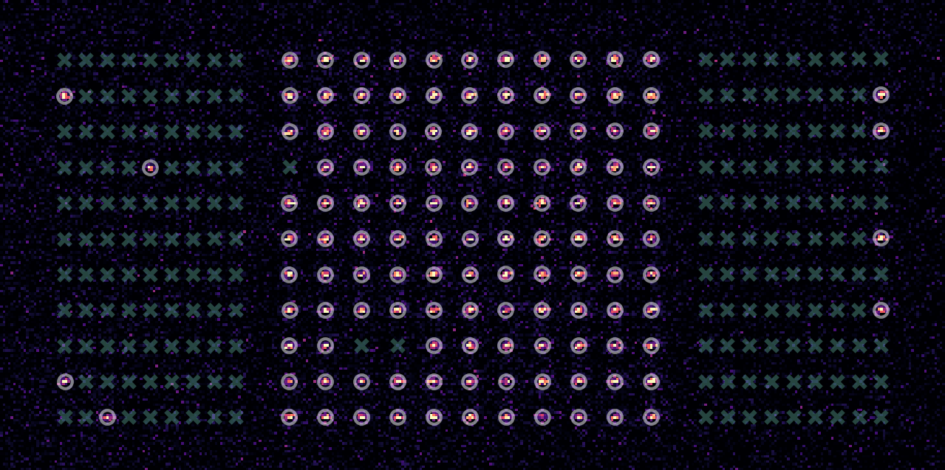
QPU cycle
Coherent evolution
15ms
20ms
5ms
15ms
40ms
5ms
20us
15ms
40ms
5ms
5ms
Notes:
We build the processor at each shot.
Large dynamic range of time: 100s of ms duration for QPU cycle and calibrations, to 10s of ms duration prep step, to 0.1-20us Hamiltonian control analog waveforms with 10ns timing precision.
Crossover from ms to ns.

Slide 9
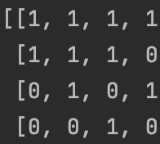
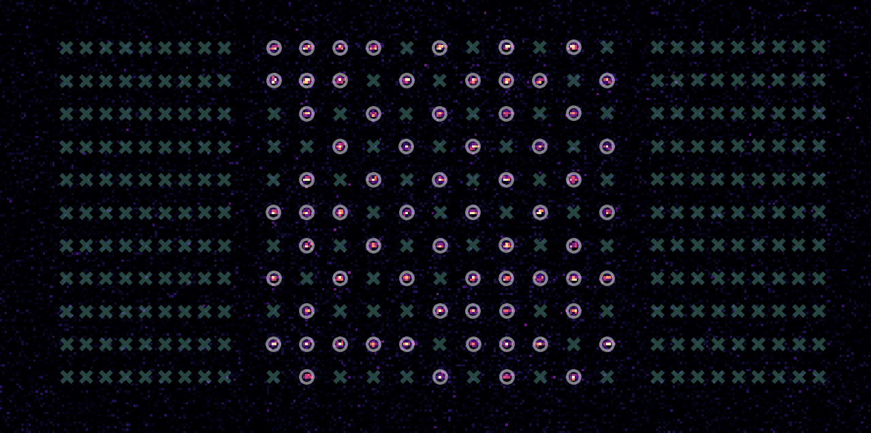
QPU cycle
State detection
> 95%
15ms
20ms
5ms
15ms
40ms
5ms
20us
15ms
40ms
5ms
5ms
Notes:
We build the processor at each shot.
Large dynamic range of time: 100s of ms duration for QPU cycle and calibrations, to 10s of ms duration prep step, to 0.1-20us Hamiltonian control analog waveforms with 10ns timing precision.
Crossover from ms to ns.

Slide 10
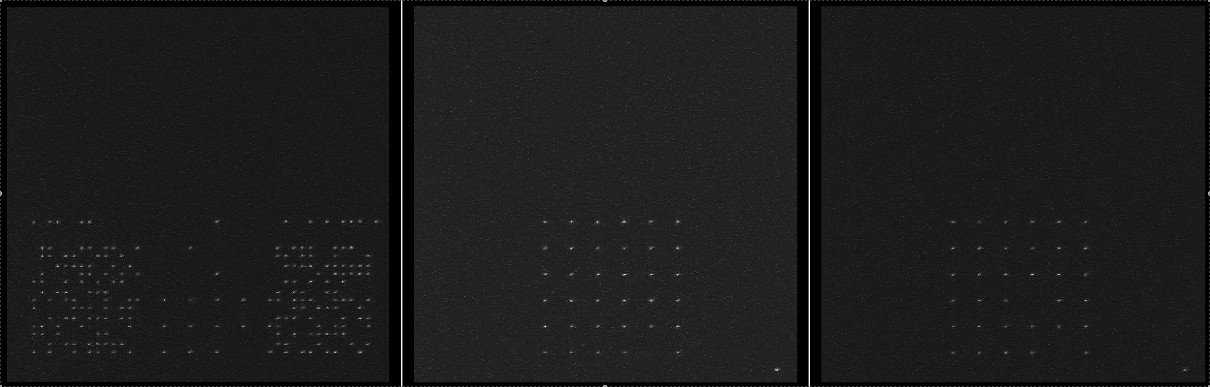
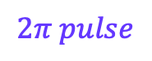
What qubit control really looks like:
$$2π pulse$$

Slide 11
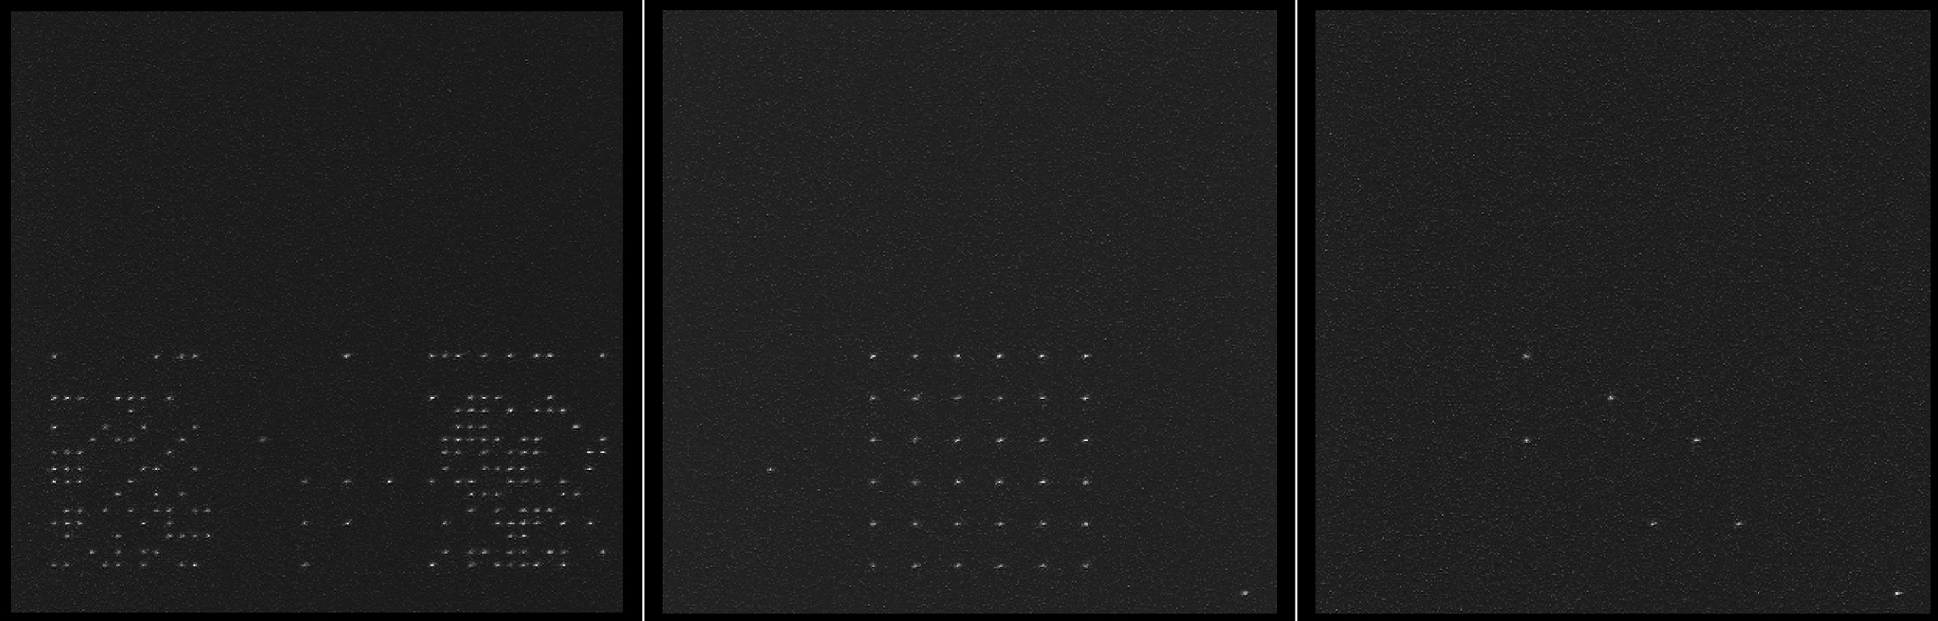
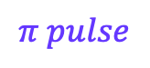
What qubit control really looks like:
$$π pulse$$

Slide 12
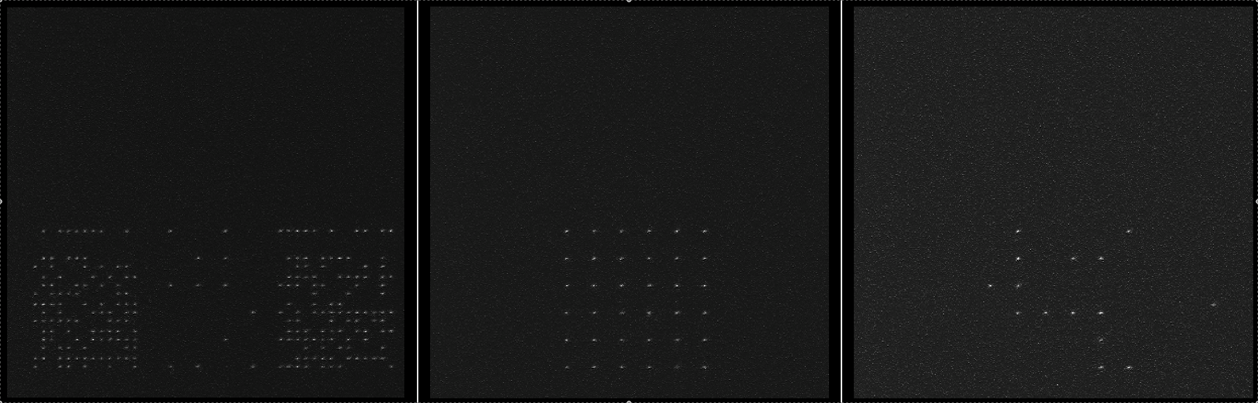
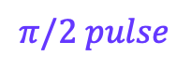
What qubit control really looks like:
$$π/2 pulse$$

Slide 13
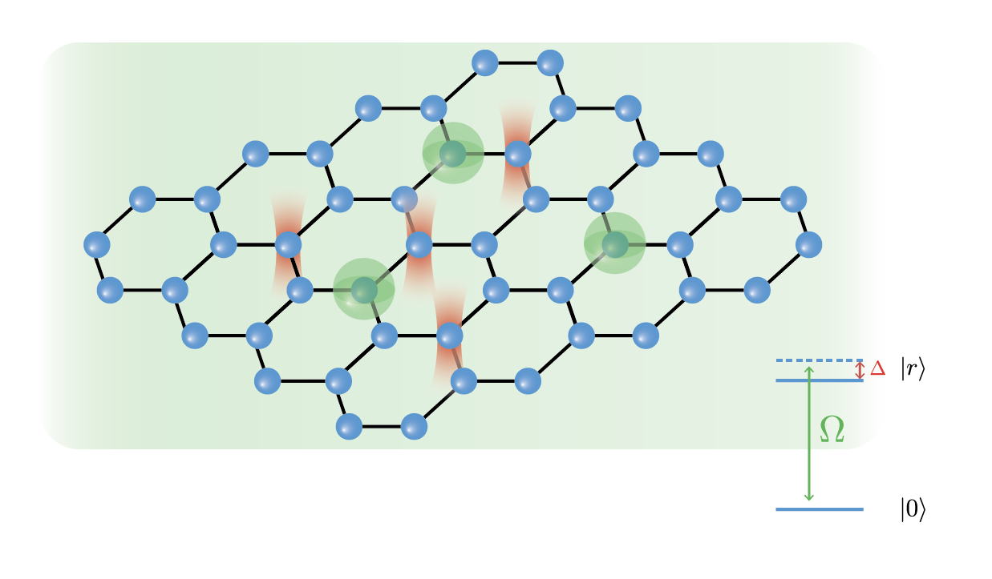
A neutral-atom quantum processor
Dynamics
(algorithms)
Geometry

Slide 14
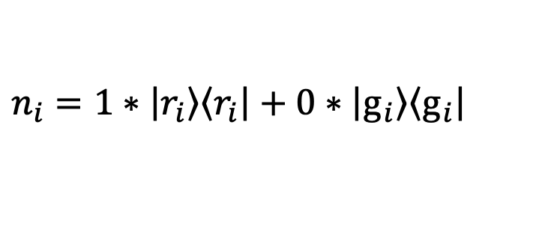
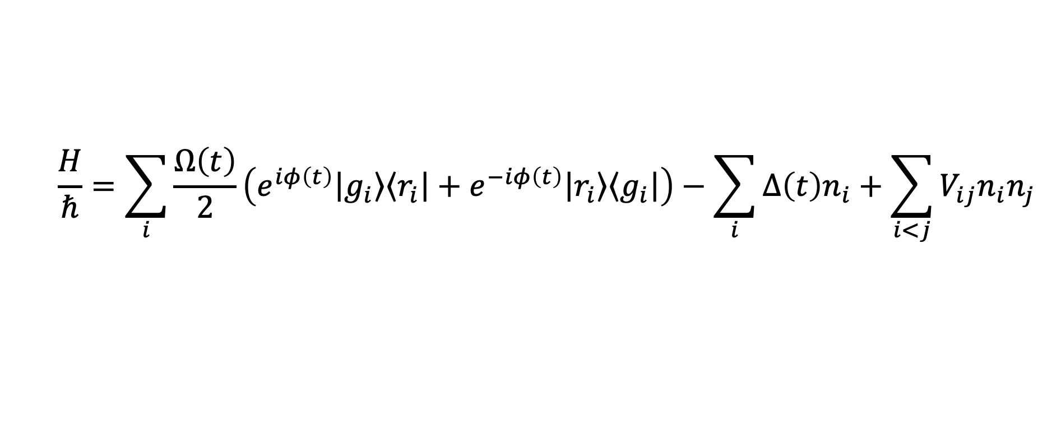
Analog quantum dynamics control
$$\frac{H}{ℏ}=\sum_{i}{\frac{Ω\left(t\right)}{2}\left(e^{iφ\left(t\right)}\left|\left.g_{i}\right\rangle \right.\left\langle \left.r_{i}\right|\right.+e^{−iφ\left(t\right)}\left|\left.r_{i}\right\rangle \right.\left\langle \left.g_{i}\right|\right.\right)−\sum_{i}{Δ\left(t\right)n_{i}}+\sum_{i<j}{V_{ij}n_{i}n_{j}}}$$
$$n_{i}=1∗\left|\left.r_{i}\right\rangle \right.\left\langle \left.r_{i}\right|\right.+0∗\left|\left.g_{i}\right\rangle \right.\left\langle \left.g_{i}\right|\right.$$

Slide 15
Hardware constraints: Geometry
1
2
3
Always in rows
4
5
6
8
9
7
More details @
https://queracomputing.github.io/Bloqade.jl/dev/capabilities/

Slide 16
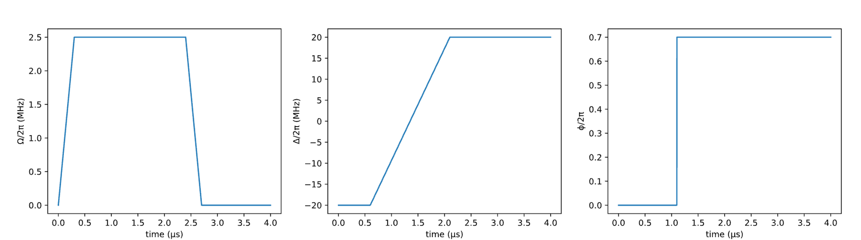
Hardware constraints: dynamics
Activity: Encoding waveforms on Bloqade
Piecewise-linear
Piecewise-constant

Slide 17

Rydberg blockade: phenomenology

Slide 18
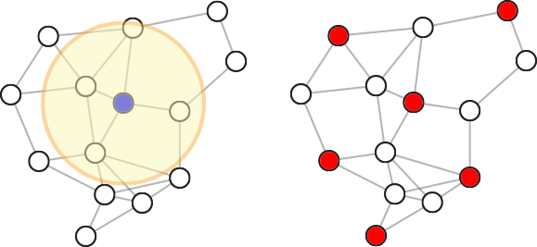
Rydberg blockade: utility
Maximum
Independent
Set
(NP-Complete)
Adapted from Ebadi et. al Science, 376, 6598 (2022)
18

Slide 19
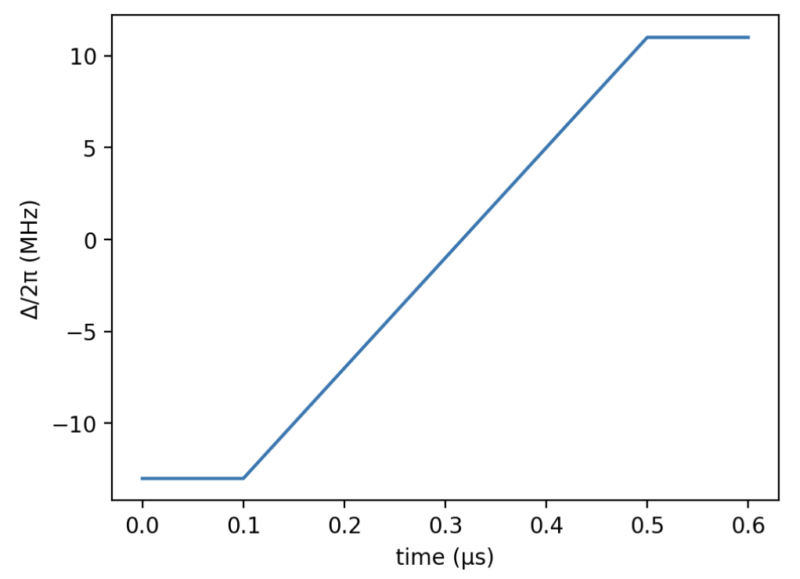
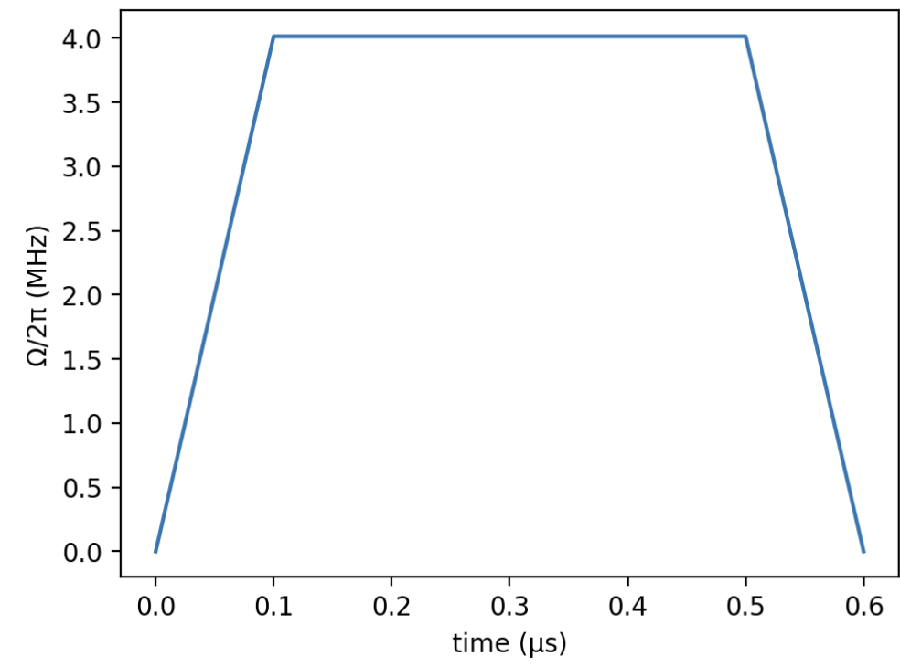
An algorithm for MIS

Slide 20
An algorithm for MIS

Slide 21
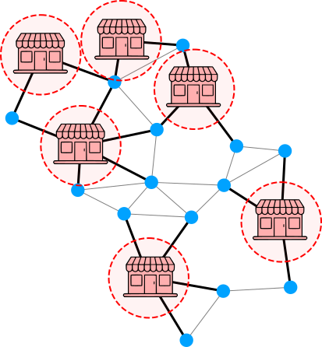
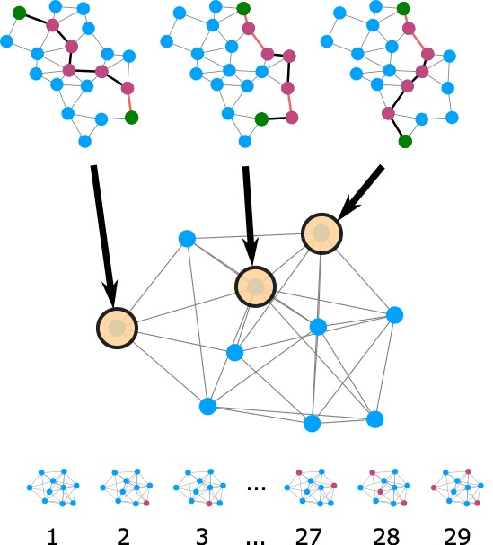
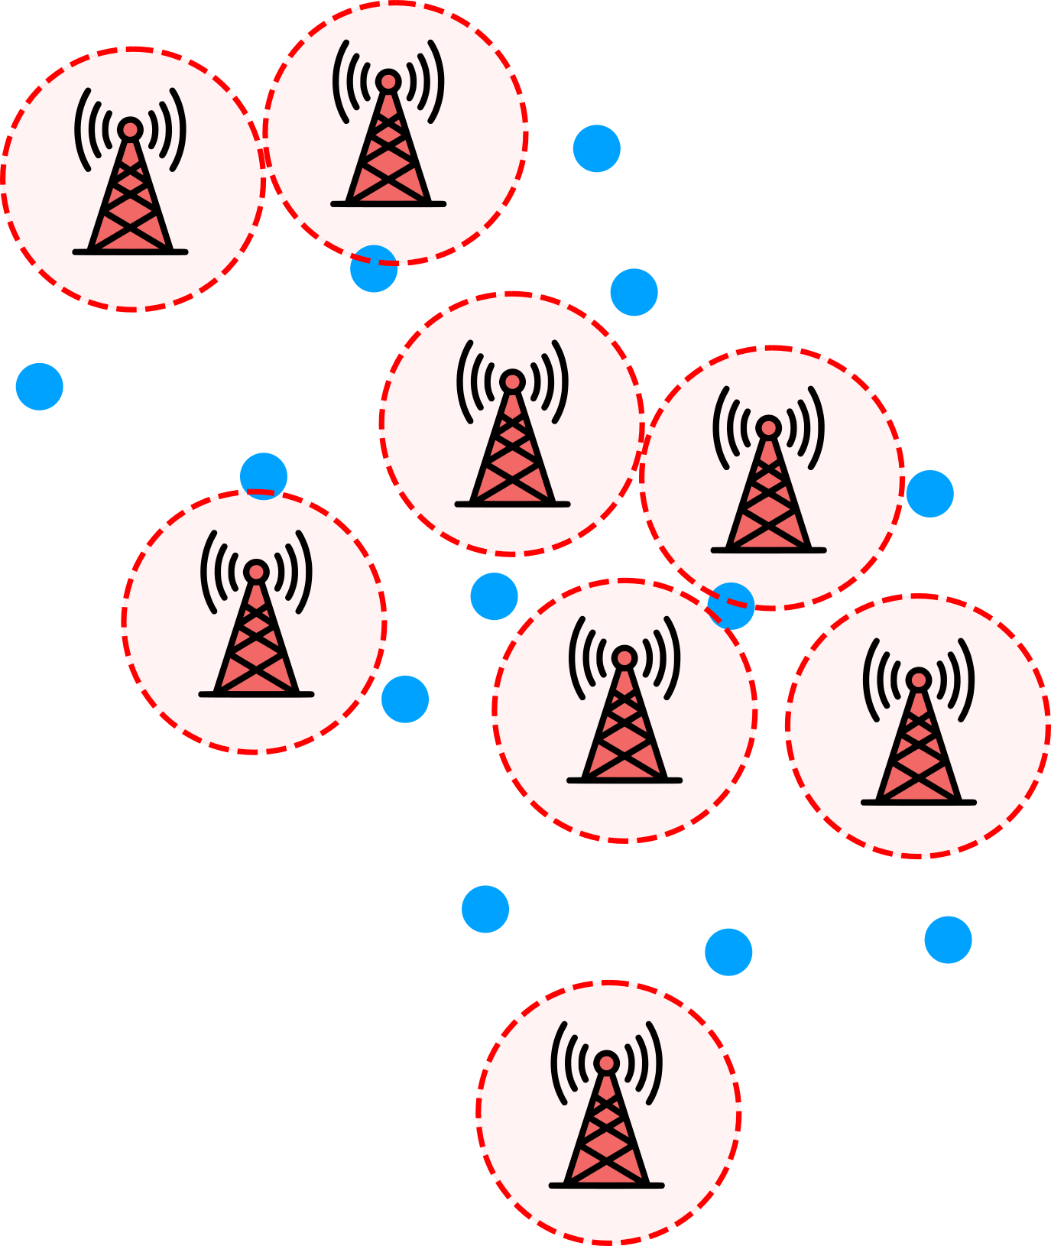
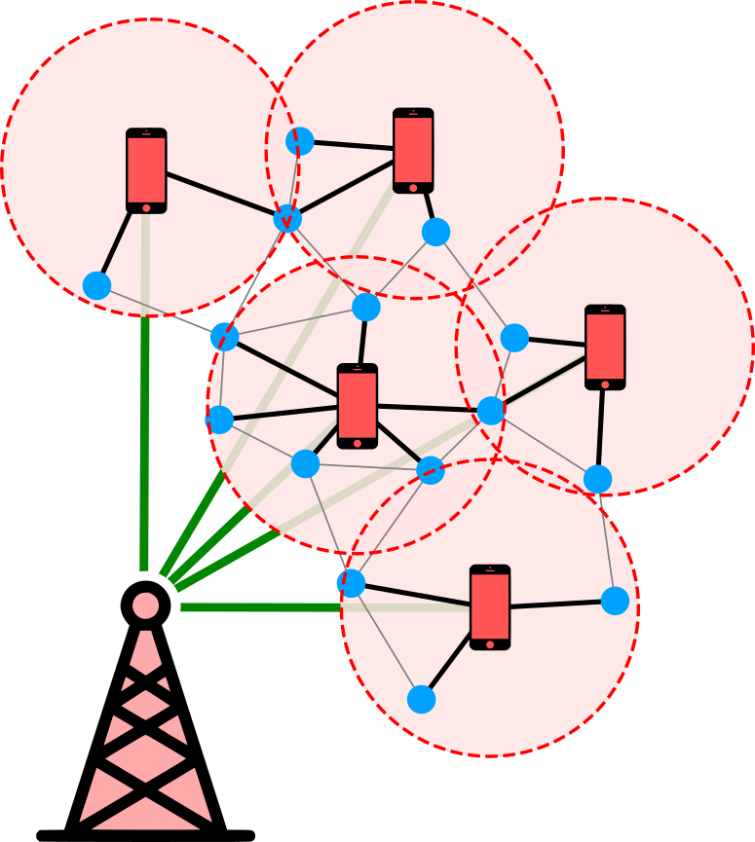
MIS applications are ubiquitous
Wurtz et al., “Industry applications of neutral-aom quantum computing solving independent set problems” https://arxiv.org/abs/2205.08500

Slide 22
Programming neutral atoms in 5 steps
Define atom positions => Rydberg radius
Define time traces of Hamiltonian parameters
Initialize Hamiltonian
Evolve!
Measure!

